Slide 1
Commercial and SME banking
Summary document
June 2026

Slide 2
PASHA Bank commercial and SME segments have unique challenges and opportunities
detailed 2026 forecast figures have not been provided. Once the forecast is provided, ANALYSIS FIGURES CAN BE UPDATED
Commercial
SME
Key metrics of PASHA Bank commercial and SME segments
PASHA Bank commercial and SME segments business overview
Total number of customers, ‘000 #
Inactive customer base
Both segments have a large untapped client base, especially SME (driven by micro) and commercial
36.9
40.7
44.6
0.6
0.6
0.7
Low cross-sell ratio
Relationship depth lags peers, with Commercial at 2.6 products/client vs 3.3 peers and SME at 1.5 vs 2.0, limiting revenue per customer
Active share, %
63%
62%
56%
43%
36%
32%
Limited deposit base
Both segments underperform on liability capture, with current account balances below peers, reducing funding benefits and relationship profitability
Loan portfolio, AZN MN¹
471
455
403
358
260
273
Cash mgmt. monet.
Cash management income per customer is materially below peers: AZN 35.5k vs 60.7k in Commercial and AZN 2.1k vs 4.2k in SME
Market share, %
N/A
N/A
N/A
~4%
~4%
~4%
Lending penet.
Lending penetration remains below benchmark levels, at 63% vs 68% peers in Commercial and 30% vs 38% peers in SME, leaving room for selective loan growth
Cost of risk, % of loan volume²
6.9%
5.8%
1.2%
Manual credit process.
Manual credit decisioning limits speed, scalability, and customer experience; automation is needed to reduce time-to-yes and improve risk control
0.1%
0%
0.3%
2023
24
2025
1. Commercial market share not available since not reported in CBAR
2. Commercial and corporate combined

Slide 3
Addressing challenges can help PASHA Bank to reach AZN 121 MN NBI by 2029
detailed 2026 forecast figures have not been provided. Once the forecast is provided, ANALYSIS FIGURES CAN BE UPDATED
Commercial
SME
Preliminary - to be further verified
Number of customers, ‘000 #
Net banking income, AZN MN
1,0
121
0,8
0,9
0,9
61,7
104
49,4
53,6
57,8
87
Market share, %
50%
52%
53%
54%
71
38%
39%
39%
40%
Loan portfolio, AZN Mn
1,259
1,436
872
1,054
2026 (F)
27 (F)
28 (F)
2029 (F)
2026 (F)
27 (F)
28 (F)
2029 (F)
Market share¹, %
N/A
N/A
N/A
N/A
NFI/NBI, %
38%
37%
36%
36%
5%
6%
6%
6%
48%
48%
49%
50%
1. Commercial market share not available since not reported in CBAR

Slide 4

PASHA Bank commits to follow a holistic strategy in commercial and SME segments to unlock its growth trajectory to 2029
Optimize and selectively scale commercial and SME banking
Transaction banking-led ecosystem platform
CIB counterparties acquisition
Commercial and micro reactivation program
Supply chain / trade products double-down
Credit process transformation
E2E business partnership beyond banking
Next-gen pricing and product bundling
Change to support growth
Best-in-class CX
Fit for future tech & AI
Robust risk management

Slide 5
PASHA Bank’s strategy in commercial and SME banking consists of 6 initiatives and 3 enablers
Strategic programs
Initiatives
Scope
Transaction banking-led ecosystem platform
CIB counterparties acquisition
Leverage existing payment data and additional insights captured via the Transaction banking-led ecosystem platform supply chain module to identify vendors and distributors of existing PBA CIB customers and target them with tailored onboarding bundles
1
Supply chain / trade products double-down
Leverage existing cash flow data and additional insights captured via the Transaction banking-led ecosystem to identify customer needs and offer them trade related products
2
E2E business partnership beyond banking
Develop an ecosystem of value-added services, e.g. accounting, insurance etc., to support smaller customers, i.e. SMEs, with their beyond banking needs to generate additional income
3
Optimize and selectively scale commercial and SME banking
Commercial and micro reactivation program
Double-down on commercial and micro SME segments with tailored re-activation and churn prevention journeys and product offerings to grow active customer base
4
Credit process transformation
Revisit and transform credit process leveraging Agentic AI to 1. increase efficiency through the deployment of specific AI agents and 2. differentiate the process based on the specific needs of each segment
5
Next-gen pricing and product bundling
Optimize and personalize pricing by incorporating all-in sensitivity and relationship-based pricing principles. Define a clear approach for product bundling, leveraging actual customer data, AA, and AI to deepen relationships
6
Change to support growth
Best-in-class CX
Fit for future tech & AI
Robust risk management

Slide 6
PASHA Bank’s commercial & SME banking strategy is expected to bring an additional AZN ~60 MN net banking income
detailed 2026 forecast figures have not been provided. Once the forecast is provided, ANALYSIS FIGURES CAN BE UPDATED
Preliminary - to be further verified
NBI impact, AZN MN
Commercial & SME NBI, 2025
Impact drivers
Transaction banking-led ecosystem platform
1
CIB counterparties acquisition
New customers in Medium
120
7.9
New customers in SME
~14500
2
Supply chain / trade products double-down
Penetration increase in selected products
+7-15 p.p.
Total clients’ base increase
5%-8% CAGR till 2029
3
E2E business partnership beyond banking
4.0
At least 3% of NBI by 2029
Additional NBI
Optimize and selectively scale commercial and SME banking
4
Commercial and micro reactivation program
7.0
Reactivated clients in Comm.
35-40
Reactivated clients in SME
Over 2 ths
5
Underwriting revamp
Increased penetration in loans
+10-15 p.p.
14.0
Increased the total clients’ base
5%-8% CAGR till 2029
6
Next-gen pricing and product bundling
7.0
Improved NICM
X1.15
Commercial & SME NBI, 2029

Slide 7
PASHA Bank’s strategy in commercial and SME banking consists of 6 initiatives and 3 enablers
Strategic programs
Initiatives
Scope
Transaction banking-led ecosystem platform
CIB counterparties acquisition
Leverage existing payment data and additional insights captured via the Transaction banking-led ecosystem platform supply chain module to identify vendors and distributors of existing PBA CIB customers and target them with tailored onboarding bundles
1
Supply chain / trade products double-down
Leverage existing cash flow data and additional insights captured via the Transaction banking-led ecosystem to identify customer needs and offer them trade related products
2
E2E business partnership beyond banking
Develop an ecosystem of value-added services, e.g. accounting, insurance etc., to support smaller customers, i.e. SMEs, with their beyond banking needs to generate additional income
3
Optimize and selectively scale commercial and SME banking
Commercial and micro reactivation program
Double-down on commercial and micro SME segments with tailored re-activation and churn prevention journeys and product offerings to grow active customer base
4
Credit process transformation
Revisit and transform credit process leveraging Agentic AI to 1. increase efficiency through the deployment of specific AI agents and 2. differentiate the process based on the specific needs of each segment
5
Next-gen pricing and product bundling
Optimize and personalize pricing by incorporating all-in sensitivity and relationship-based pricing principles. Define a clear approach for product bundling, leveraging actual customer data, AA, and AI to deepen relationships
6
Change to support growth
Best-in-class CX
Fit for future tech & AI
Robust risk management

Slide 8
B2B ecosystem will allow to unlock SME growth by connecting CIB and SMEs through common ecosystem flows
1
Ecosystem Play
Supply chain module will target domestic value chains and ecosystem banking products will be offered
Key questions
Suggested approach
Value to PBA
Why do this?
Mapping E2E value chains across Azerbaijan allows to uncover CIB client’s key SME and commercial networks
Creates natural acquisition pipeline for SME and commercial clients
Increases non-lending revenue
Ecosystem Network
Who do we target?
SMEs inside the anchor's chain, prioritizing Medium and Small sub-segments
Focuses on highest-conversion/highest value prospects
Suppliers
Buyers
Property
Property
Caspian Building MMC Azerbaijan
Urban Development MMC Azerbaijan
How do we win them?
Leading with SC and TxB products
Offering trade sector specific product bundles
Increasing penetration within SME clients and commercial clients
Global Materials MMC Germany
Golden City MMC Azerbaijan
Manufacturing
Leasing
Azer Texnika MMC Azerbaijan
Pasha
Construction MMC
Azerbaijan
Capital Leasing MMC Azerbaijan
How do we grow the relationship?
Layering beyond-banking / VAS module onto the platform to embed PBA in clients' daily operations
Increase stickiness of SME/commercial clients
Reduces churn
Baku Metals MMC Azerbaijan
Finance Rent MMC Azerbaijan

Slide 9
Activating B2B ecosystem will unlock new pools of value through targeted acquisition of SME customers
1
Preliminary - to be further verified
# of SME counterparties, ‘000
Sub-segment level results
Key implications
Non-PBA SME counterparties
# of SMEs customers acquired, ths
2029 NBI increment, mn AZN
10% of CIB counterparties base
or
15 ths new clients
PBA SME counterparties
Avg NBI, ths AZN
CIB (active clients)
174.7
Total
15.0
0.5
7.9
  can be acquired leveraging Transaction-banking led B2B Ecosystem
Medium
0.1
21.0
2.5
149.8
96.4
Small
0.3
3.7
1.1
82.7
1.3
1.5
Micro
14.6
0.3
4.4
2025
2029

Slide 10
PASHA Bank’s strategy in commercial and SME banking consists of 6 initiatives and 3 enablers
Strategic programs
Initiatives
Scope
Transaction banking-led ecosystem platform
CIB counterparties acquisition
Leverage existing payment data and additional insights captured via the Transaction banking-led ecosystem platform supply chain module to identify vendors and distributors of existing PBA CIB customers and target them with tailored onboarding bundles
1
Supply chain / trade products double-down
Leverage existing cash flow data and additional insights captured via the Transaction banking-led ecosystem to identify customer needs and offer them trade related products
2
E2E business partnership beyond banking
Develop an ecosystem of value-added services, e.g. accounting, insurance etc., to support smaller customers, i.e. SMEs, with their beyond banking needs to generate additional income
3
Optimize and selectively scale commercial and SME banking
Commercial and micro reactivation program
Double-down on commercial and micro SME segments with tailored re-activation and churn prevention journeys and product offerings to grow active customer base
4
Credit process transformation
Revisit and transform credit process leveraging Agentic AI to 1. increase efficiency through the deployment of specific AI agents and 2. differentiate the process based on the specific needs of each segment
5
Next-gen pricing and product bundling
Optimize and personalize pricing by incorporating all-in sensitivity and relationship-based pricing principles. Define a clear approach for product bundling, leveraging actual customer data, AA, and AI to deepen relationships
6
Change to support growth
Best-in-class CX
Fit for future tech & AI
Robust risk management

Slide 11
PBA can translate cash-flow insights into targeted trade product offers
detailed 2026 forecast figures have not been provided. Once the forecast is provided, ANALYSIS FIGURES CAN BE UPDATED
2
Preliminary - to be further verified
2025 penetration, %
2029 penetration, %
Next-best-product mechanism
Key products penetration
Net-fee income
Dom. Payments
Intl. Payments
2025
2029
2025
2029
  Cash-flow patterns predict product need (FX, trade finance, working capital loan) before the client applies for it
  Codified thresholds can be applied to automatically send next-best-product offer, making cross-sell systematic and scalable
  Capture begins with high-frequency, low-friction products (domestic payments, accounts) that generate the data, then expands into higher-margin products (LC/LG, intl. payments, FX)
  Each incremental product increases non-interest income and stickiness simultaneously
LC/LG
FX
MN AZN
% of total NBI
14
60
29
36
Commercial
24
63
32
46
12
22
37%
36%
1
30
3
5
SME
3
29
4
5
13
30
46%
50%
15
96
43
48
  Medium
35
96
48
63
10
22
48%
53%
5
92
15
21
  Small
25
92
30
21
3
6
37%
36%
0
22
1
1
  Micro
0
22
1
1
1
2
53%
79%
1
30
4
5
Total
3
30
5
5
25
52
41%
43%

Slide 12
For Next-Product-To-Buy, banks use collaborative filtering and propensity models to drive a 10-15% revenue uplift
2
Next-Product-To-Buy Engine
Input
Model
Output
Internal data
  Client information (Industry, coverage)
  Credit information (e.g., volume by maturity, drawn)
  Product revenue/volume with +40 categories
  Commercial activities (e.g., client meetings, opportunities)
  Business flow (e.g., payments)
Opportunity by client
uses behaviour of similar customers to inform what customer may like
Group – Sub.
Products
Potential
007 – Subsidiary UK
Import Finance
20k€
Collaborative
filtering model
based on product revenue/ volume
007 – Subsidiary New York
DCM (Dollar issuance)
50k€
010 – Head-quarter
Factoring
65k€
Propensity model based on client info and external
data
012 – Head-quarter
Cash pooling
10k€
External data
  Client financials (e.g., turnover, EBITDA, ROE)
  Industry data (e.g., sector growth and profitability)
  Non client information (financials and product)
2123 – Head-quarter
Rates derivatives
35k€
uses the internal and external data sources and applying machine learning
Source: Team analysis

Slide 13

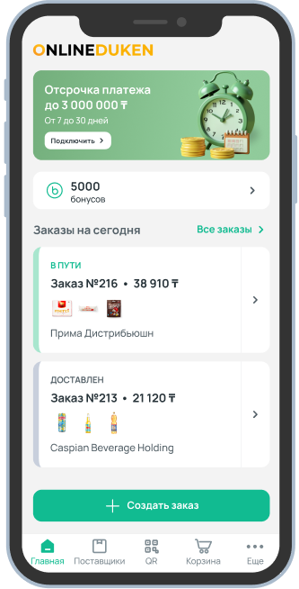
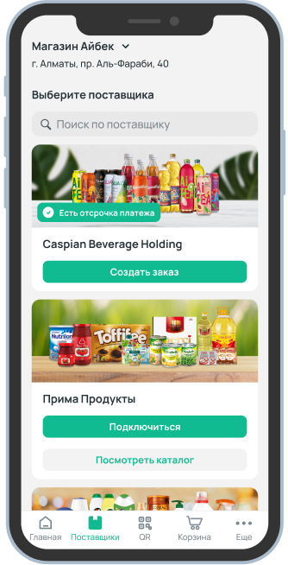
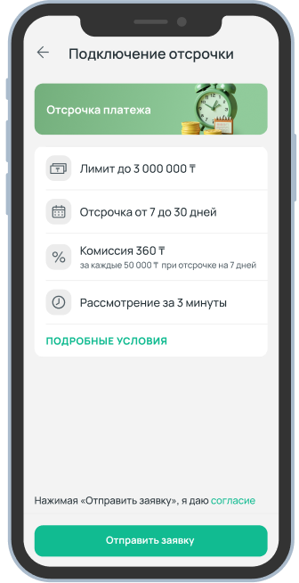
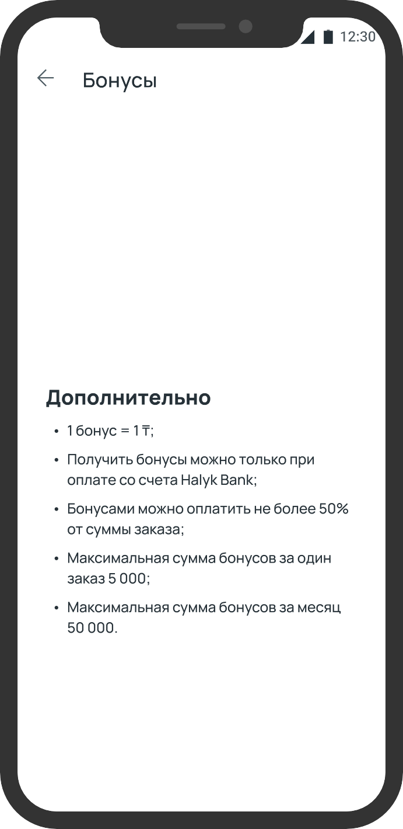












Halyk bank built B2B Ecosystem, centered around FMCG trade, connecting wholesale distributors and grocery stores
2
OnlineDuken Case example
Key implications for PBA
OnlineDuken digitizes the full cycle of ordering, deliveries and payments between wholesale distributors and grocery stores
Impact
  Industry focus helps drive adoption, since offered products, terms and even VAS will be tailor to specific customer needs:
    Halyk specifically highlights distributors relevant for FMCG players
  Alongside fast adoption, PBA can expect higher stickiness, since sector-specific bundles (terms, limits, rewards tuned to the trade) are harder to replicate and harder to leave than commodity banking
Embedded supply chain financing
$85m GMV one year after launch
70+ wholesale distributors’ product catalogue available
Loyalty program for merchants
~10% share of wholesale grocery market by end of year
~20% of grocery shops in the country are users
+16% in average
bank balance per user
vs non-user
Launched in 9 months

Slide 14
PASHA Bank’s strategy in commercial and SME banking consists of 6 initiatives and 3 enablers
Strategic programs
Initiatives
Scope
Transaction banking-led ecosystem platform
CIB counterparties acquisition
Leverage existing payment data and additional insights captured via the Transaction banking-led ecosystem platform supply chain module to identify vendors and distributors of existing PBA CIB customers and target them with tailored onboarding bundles
1
Supply chain / trade products double-down
Leverage existing cash flow data and additional insights captured via the Transaction banking-led ecosystem to identify customer needs and offer them trade related products
2
E2E business partnership beyond banking
Develop an ecosystem of value-added services, e.g. accounting, insurance etc., to support smaller customers, i.e. SMEs, with their beyond banking needs to generate additional income
3
Optimize and selectively scale commercial and SME banking
Commercial and micro reactivation program
Double-down on commercial and micro SME segments with tailored re-activation and churn prevention journeys and product offerings to grow active customer base
4
Credit process transformation
Revisit and transform credit process leveraging Agentic AI to 1. increase efficiency through the deployment of specific AI agents and 2. differentiate the process based on the specific needs of each segment
5
Next-gen pricing and product bundling
Optimize and personalize pricing by incorporating all-in sensitivity and relationship-based pricing principles. Define a clear approach for product bundling, leveraging actual customer data, AA, and AI to deepen relationships
6
Change to support growth
Best-in-class CX
Fit for future tech & AI
Robust risk management

Slide 15
PBA can drive customer retention through value added services adoption
3
Suggested focus areas
Preliminary - to be further verified
Globally, 30% of SMEs are willing to use and pay for “beyond banking” services…
…While locally 37% of SMEs expressed such interest
Key Implications for PBA
Willingness to use online/mobile business tools provided by bank
"How would you categorize your usage of the following types online/mobile tools in your business?" &"Would it be valuable if any of these services would be provided by your bank?"
Potential to use non-banking services, % of responses
PBA's current offerings already serve corporate counterparty needs:
  Counterparty check
  Cash management support
  Contract management
  Finance (Tax) Guide
  Payroll solutions
These can be extended with two types of value-added services:
  Daily business support:
    Finance/accounting software
    Legal advisory
  Specialized on-demand services:
    Business consulting
    Operations consulting
Customer delivery
15%
Sales increase training/classes
10%
Currently using (%)
Online accounting/
accountant consultations
7%
65
60
Finance and accounting software
Targeted advertising support
5%
55
Expense tracking software/tool
Legal advice
4%
50
Payroll solutions
45
HR/ People Management/ Time Keeping
Service for online
registration of clients
2%
40
Inventory and logistics management
Marketing and analytics tool
Legal support
Website builder, web pages
2%
35
ERP Software Provider
30
Sales/demand online analytics
1%
29
30
31
32
33
34
35
36
37
Provided by bank, willing to pay (%)
Total interested
37%
Source: McKinsey and Company Europe SME survey, n=1989

Slide 16
PASHA Bank’s strategy in commercial and SME banking consists of 6 initiatives and 3 enablers
Strategic programs
Initiatives
Scope
Transaction banking-led ecosystem platform
CIB counterparties acquisition
Leverage existing payment data and additional insights captured via the Transaction banking-led ecosystem platform supply chain module to identify vendors and distributors of existing PBA CIB customers and target them with tailored onboarding bundles
1
Supply chain / trade products double-down
Leverage existing cash flow data and additional insights captured via the Transaction banking-led ecosystem to identify customer needs and offer them trade related products
2
E2E business partnership beyond banking
Develop an ecosystem of value-added services, e.g. accounting, insurance etc., to support smaller customers, i.e. SMEs, with their beyond banking needs to generate additional income
3
Optimize and selectively scale commercial and SME banking
Commercial and micro reactivation program
Double-down on commercial and micro SME segments with tailored re-activation and churn prevention journeys and product offerings to grow active customer base
4
Credit process transformation
Revisit and transform credit process leveraging Agentic AI to 1. increase efficiency through the deployment of specific AI agents and 2. differentiate the process based on the specific needs of each segment
5
Next-gen pricing and product bundling
Optimize and personalize pricing by incorporating all-in sensitivity and relationship-based pricing principles. Define a clear approach for product bundling, leveraging actual customer data, AA, and AI to deepen relationships
6
Change to support growth
Best-in-class CX
Fit for future tech & AI
Robust risk management

Slide 17
Commercial and Micro demonstrate the largest share of inactive clients
4
Detailed further
Inactive customers, %¹
CAGR, inactive,
2023-2025, %
Inactive customers ¹, 2025, ‘000
Segment
Key implications
Corporate
>100 Mn annual turnover
32%
35-40 commercial clients
and
2k+ Micro clients
+5%
Commercial
>15 Mn annual turnover
44%
Medium
1-15 Mn turnover
2%
-17%
of the dormant clients can be reactivated
Small
200k-1 Mn turnover
5%
-7%
5-7 Mn AZN annual NBI uplift
Micro
Less than 200k turnover
30.516
77%
+26%
can be achieved as a result of reactivation and churn rate reduction
Total
31.493
66%
+26%
1. Activity status is based on the number of transactions (e.g., 2+/month for CIB), active operations or account balance above threshold for the segment

Slide 18
Targeted dormant clients base: Commercial
4
2025, Commercial
Preliminary - to be further verified
Nonactive since 2023
Left in 2024
Left in 2025
Key insights
Reactivation targets
  50% of the current dormant customers left the Bank in 2024-2025 with the highest potential reactivation rate¹ of 15%-25%
  The potential average weighted reactivation rate will account for 14%²
  Reactivation rate1 accounted for meager ~4% (11 clients) in 2025
  Churn rate remains rather moderate at 14% in 2025
Total inactive
clients
28%
(70)
Defunct
companies
254
50%
(126)
23%
(58)
Targeted group
(dormant clients)
Reactivation of the current dormant client base² (14%) will secure additionally 35-40 active customers and 4-5 mn² AZN of the annual Net Banking Income
Calculated as the number of the reactivated clients divided by the dormant client base
The reactivation rate accounts for 25% for the customers left in 2025, 15% - for the clients left in 2024 and 7% for the clients inactive from 2023
3. Calculated based on 2029 benchmark of 0,11 mn of the AZN net banking revenue per one Commercial client
18

Slide 19
Targeted dormant clients base: Micro
4
2025, Micro
Preliminary - to be further verified
Nonactive since 2023
Left in 2024
Left in 2025
Key insights
Thousand
Total inactive
clients
30,516
Reactivation targets
  Over 50% of the current dormant customers left the Bank in 2024-2025 with the highest potential reactivation rate¹ of 15%-25%
  The potential average weighted reactivation rate will account for 13%²
  Current reactivation rate decreased to less than 3% (355 clients) in 2025 vs 8% in 2024
  Churn rate got to a high level of 42% in 2025 though improved vs 2024 (48%)
Tabaterra related
entities
2,738
23%
(3,481)
15.2
48%
(7,372)
Defunct
companies
12,561
29%
(4,364)
Targeted group
(dormant clients)
15,217
Reactivation of the current dormant client base² (13%) will secure additionally over 2 ths active customers and 0.6-1 mn³ AZN of the annual Net banking Income
Reduction of the churn rate by 20 p.p. will enable to get additional 0.5-1 mn AZN of the annual Net Banking Income
Calculated as the number of the reactivated clients divided by the dormant client base
The reactivation rate accounts for 25% for the customers left in 2025, 15% - for the clients left in 2024 and 7% for the clients inactive from 2023
3. Calculated based on 2029 benchmark of 300 AZN of the net banking revenue per one Micro client
19

Slide 20
Potential initiatives aimed at reactivating the dormant client base
4
Based on the preliminary analysis
Targeting & Prioritization
  Deploy AI models to rank inactive clients based on their net banking income and reactivation probability to concentrate RM time on high-value clients
  Based on ecosystem data and external signals (e.g., continued tax activity, incoming counterparty payments) identify those, who are “inactive in PBA but active elsewhere“
  Utilize automated AI engines to trigger campaign touchpoints precisely around tax deadlines, fiscal year-ends, or seasonal working-capital cycles to maximizeconversion relevance.
Outreach & Engagement
  Re-engage clients organically by embedding their accounts back into the supply chain and payment flows of active CIB anchor clients
  Deploy Agentic AI workflows to pre-populate client data and digitally refresh KYC, eliminating physical paperwork and branch visits to deliver a near-zero-cost path back
Value prop. and hook
  Offer concrete, immediate credit limits ("AZN X is ready to deploy") using automated AA pre-scoring to bypass manual credit hurdles
  Immediately layer in low-touch digital Value-Added Services (VAS) and automated transactional hooks to transform a one-off "welcome back" into durable re-engagement
  Win back the principal operating account by recapturing payroll mandates and offering daily-use Value-Added Services (VAS) like e-invoicing and accounting integrations
Incentives &
Enablers
  Align RM compensation directly with successful client reactivation and long-term retention metrics
  Leverage digital tools and automated processes to optimize campaign efficiency and manage volume at scale

Slide 21
PASHA Bank’s strategy in commercial and SME banking consists of 6 initiatives and 3 enablers
Strategic programs
Initiatives
Scope
Transaction banking-led ecosystem platform
CIB counterparties acquisition
Leverage existing payment data and additional insights captured via the Transaction banking-led ecosystem platform supply chain module to identify vendors and distributors of existing PBA CIB customers and target them with tailored onboarding bundles
1
Supply chain / trade products double-down
Leverage existing cash flow data and additional insights captured via the Transaction banking-led ecosystem to identify customer needs and offer them trade related products
2
E2E business partnership beyond banking
Develop an ecosystem of value-added services, e.g. accounting, insurance etc., to support smaller customers, i.e. SMEs, with their beyond banking needs to generate additional income
3
Optimize and selectively scale commercial and SME banking
Commercial and micro reactivation program
Double-down on commercial and micro SME segments with tailored re-activation and churn prevention journeys and product offerings to grow active customer base
4
Credit process transformation
Revisit and transform credit process leveraging Agentic AI to 1. increase efficiency through the deployment of specific AI agents and 2. differentiate the process based on the specific needs of each segment
5
Next-gen pricing and product bundling
Optimize and personalize pricing by incorporating all-in sensitivity and relationship-based pricing principles. Define a clear approach for product bundling, leveraging actual customer data, AA, and AI to deepen relationships
6
Change to support growth
Best-in-class CX
Fit for future tech & AI
Robust risk management

Slide 22
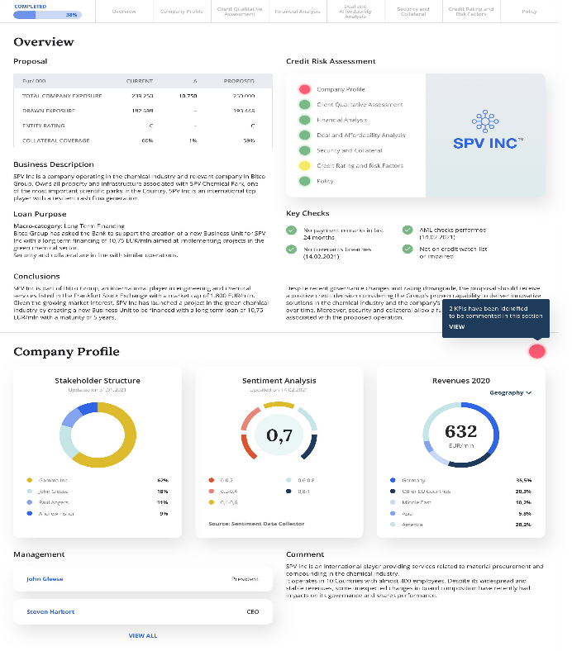
The future target corporate credit process is enabled and streamlined by Agentic AI
Illustrative
5
Illustrative
GenAI agent
Client
RM or other Bank employee
A. Client
onboarding
B. Product selection
& pricing
C. Credit risk assessment
D. Credit
approval
E. Monitoring & next product to buy
F. Collection and
NPL strategy
Client navigates multiple channels to fill out application, with personalized interactions & product offering
RM evaluates offering/ pricing generated by GenAI agents and supports the client in the process
2nd line risk officer verifies GenAI generated assessment
RM analyses and interprets GenAI generated documentation for credit approval process
RM is alerted by EWS and analyses NPL management strategies recommended by AA/ML models
Smart credit decisioning combines application data & external unstructured
data based on
client risk profile
Real-time client monitoring alerting potential financial difficulties via AA/ML models (e.g., negative news screening)
Tailored restructuring
& workout strategies suggestions
powered by
AA/ML
techniques
Front to Back
Tech platform
Combined AI-generated credit memo
Front to Back
GenAI agents platform
GenAI agent drafts outreach (e.g., e-mail) tailored to client profile
GenAI agent performs KYC analysis (e.g., beneficiary ownership identification)
Policy advisory virtual expert
Product selection virtual expert
GenAI agent fact- checks the final output and reports back for update
The contract is drafted by the GenAI agent
GenAI agent produces next product recomm-endation
Agents provide ad-hoc analysis in support to the RM
Different GenAI agents generate credit analysis (e.g., financial risk, sector, climate risk assessment)

Slide 23
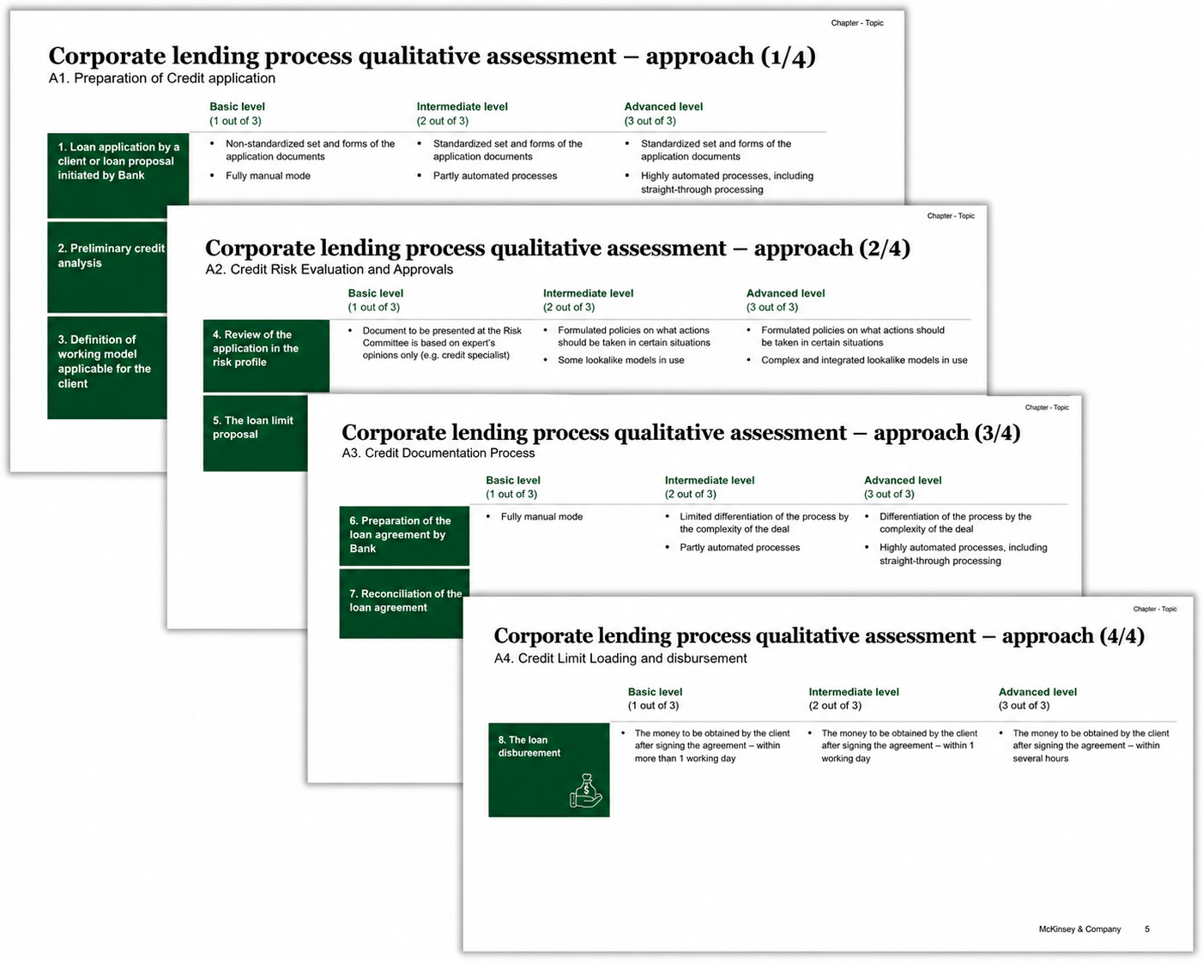
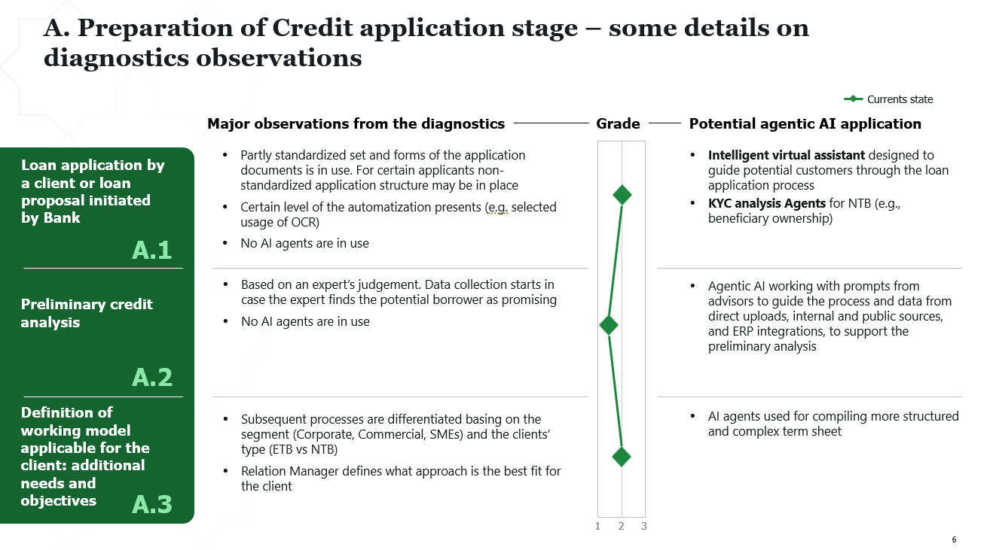
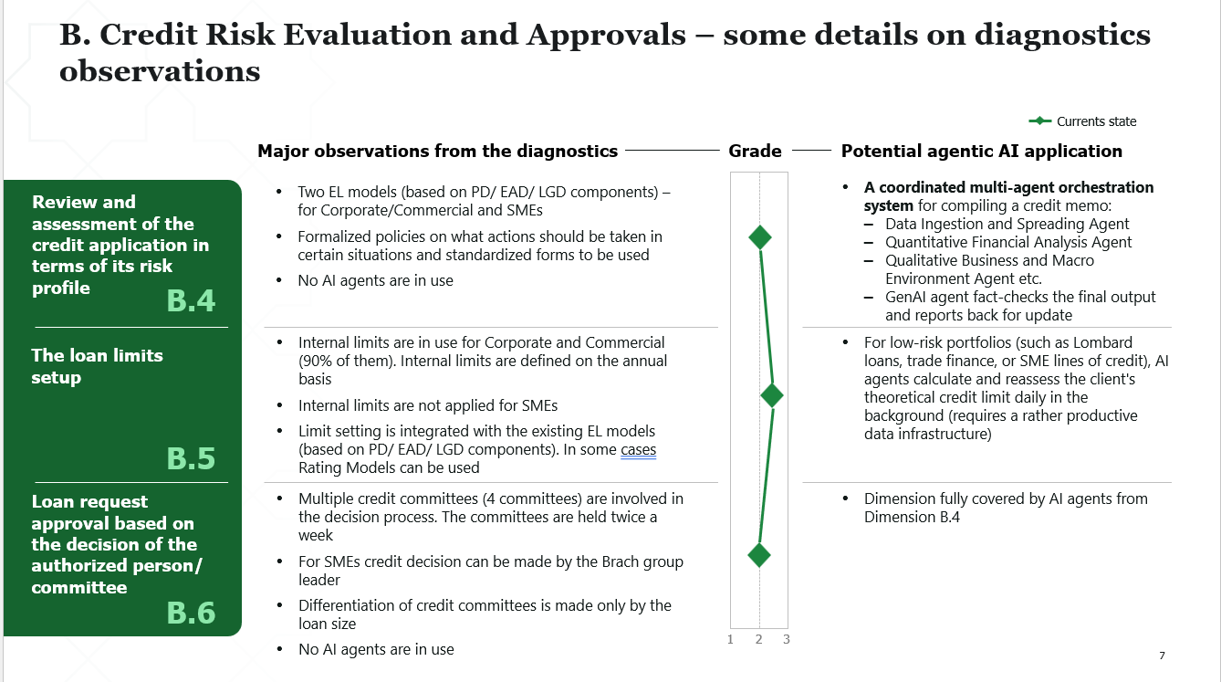
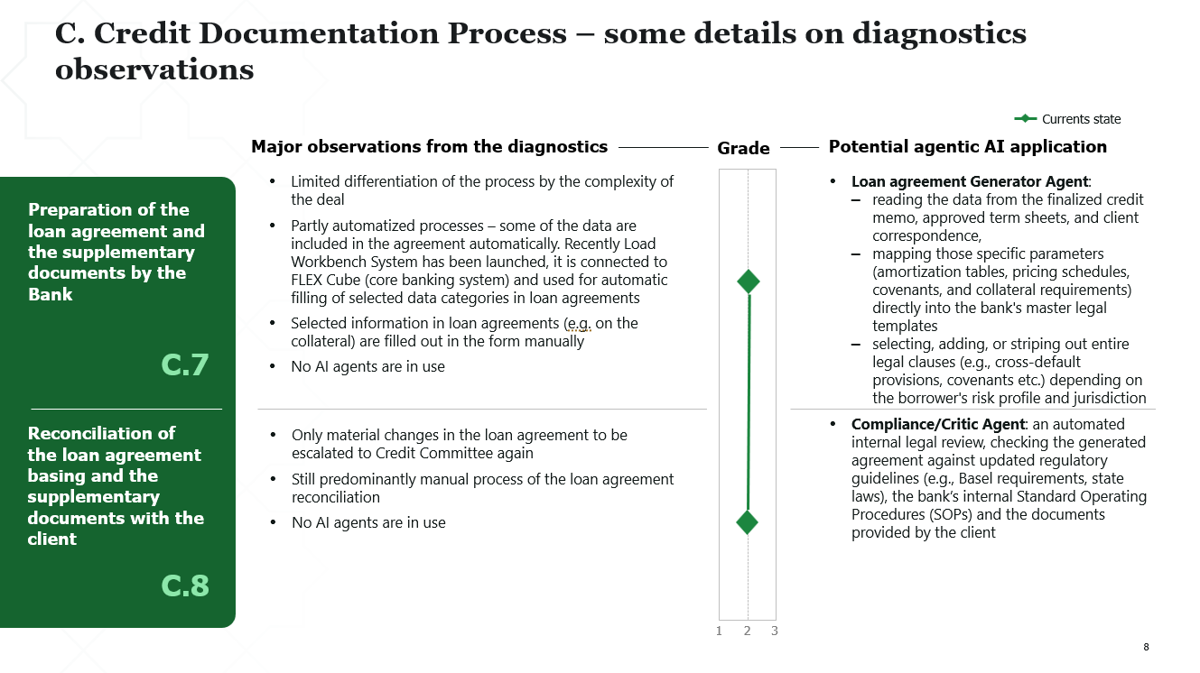
We have conducted a preliminary diagnostics of PASHA Bank credit processes for Corporate, Commercial and SME
For non-digital loans
5
More detailed observations from diagnostics: processes, automatization and AI application
Approach description

Slide 24
Corporate lending process qualitative assessment – we can streamline further the financial and credit analysis including the credit memo
5
For non-digital loans
Focus areas
Dimension
1
2
3
Preparation of Credit
application
1
Loan application by a client or loan proposal initiated by Bank
A
2
Preliminary credit analysis
3
Definition of working model applicable for the client: additional needs and objectives
Credit Risk Evaluation and Approvals
4
Review and assessment of the credit application in terms of its risk profile
B
5
The loan limits setup¹
6
Loan request approval based on the decision of the authorized person/ committee
Credit Documentation Process
7
Preparation of the loan agreement and the supplementary documents by the Bank
C
8
Reconciliation of the loan agreement basing and the supplementary documents with the client
Credit Limit Loading and disbursement
9
The loan disbursement
D
1. Not in the focus as it requires specially designed data infrastructure

Slide 25
Credit process for Corporate, Commercial and SMEs – as-is
5
For non-digital loans
Preparation of Credit application
Credit Risk Evaluation and Approvals
Credit Documentation Process
Credit disbursement
TTY/TTM
Corporate and Commercial
Standard case – 7 days
Complex case – 10-60 days
Standard case – 3 days
Complex case – 7-10 days
10-20 days/
11-21 days
1 day
4-8 hours
SME
7 days/
8 days
Standard case – 7-9 days
1 day
1-2 hours
Identified pain points to be addressed
Back-and-forth cycles with risk, credit analysis, client/ RM – multiple additional requests per application (first of all, for Corporate and Commercial). Sometimes low responsiveness from a client
Limited journey differentiation for Corporate and Commercial customers, that makes the procedures for the latter more time consuming with the lower automatization
Lack of the centralized process of pipe-line management and as a result low real-time pipeline visibility
Predominantly manual credit memo generation
Partially manual contract generation
1. TTY – Time-to-Yes, TTN – Time-to-Money

Slide 26
Credit process for Corporate, Commercial and SMEs after the processes revamp and introduction of agentic AI – to-be
5
For non-digital loans
Preliminary - to be further verified
Preparation of Credit application
Credit Risk Evaluation and Approvals
Credit Documentation Process
Credit disbursement
TTY/TTM¹
From
To
Expected effect from the grown productivity (on a yearly basis)
Corporate
Standard case – 3 days
Standard case – 3 days
10-20 days/
11-21 days
7 days/
8 days
<1 day
1-2 hours
Commercial
10-20 days/
11-21 days
5 days/
6 days
10-14 mn AZN
Standard case – 5-6 days
<1 day
1-2 hours
SME
7 days/
8 days
4 days/
5 days
Standard case – 4 days
<1 day
1-2 hours
of Pretax Profit annually starting from 2028
Agentic AI to be introduced
Intelligent virtual assistant designed to guide potential customers through the loan application process
Agentic AI working with prompts from advisors to guide the process and data from direct uploads, internal and public sources, and ERP integrations, to support preliminary analysis
A coordinated multi-agent orchestration system for compiling a credit memo – Data Ingestion and Spreading Agent, Quantitative Financial Analysis Agent, Qualitative Business and Macro Environment Agent etc.
AI assistant preparing a loan agreement and reconciling all the necessary details and terms in it
450-550 mn AZN
of annual increment in loans granted starting from 2028
1. TTY – Time-to-Yes, TTN – Time-to-Money. Moderate benchmarks of the productivity improvements are applied (40%)

Slide 27
PASHA Bank’s strategy in commercial and SME banking consists of 6 initiatives and 3 enablers
Strategic programs
Initiatives
Scope
Transaction banking-led ecosystem platform
CIB counterparties acquisition
Leverage existing payment data and additional insights captured via the Transaction banking-led ecosystem platform supply chain module to identify vendors and distributors of existing PBA CIB customers and target them with tailored onboarding bundles
1
Supply chain / trade products double-down
Leverage existing cash flow data and additional insights captured via the Transaction banking-led ecosystem to identify customer needs and offer them trade related products
2
E2E business partnership beyond banking
Develop an ecosystem of value-added services, e.g. accounting, insurance etc., to support smaller customers, i.e. SMEs, with their beyond banking needs to generate additional income
3
Optimize and selectively scale commercial and SME banking
Commercial and micro reactivation program
Double-down on commercial and micro SME segments with tailored re-activation and churn prevention journeys and product offerings to grow active customer base
4
Credit process transformation
Revisit and transform credit process leveraging Agentic AI to 1. increase efficiency through the deployment of specific AI agents and 2. differentiate the process based on the specific needs of each segment
5
Next-gen pricing and product bundling
Optimize and personalize pricing by incorporating all-in sensitivity and relationship-based pricing principles. Define a clear approach for product bundling, leveraging actual customer data, AA, and AI to deepen relationships
6
Change to support growth
Best-in-class CX
Fit for future tech & AI
Robust risk management

Slide 28



Leading banks create bundles specifically targeted for SMEs needs
6
Bank
Multi-currency a/c starter bundle
Platinum checking
Product name
Bundle 1
Bundle 2
Bundle 3
Silver checking
Gold checking
Offering
Competitive FX payments for SMEs
Perfect for SMEs with need low volume transfers
For businesses with regular international transfers
For expanding businesses to pay all stakeholders easily
For new or small businesses with basic banking needs
For businesses with more banking activity
For established businesses with higher balances
Fee structure
S$10 monthly fee Specific transaction-based fee
JOD 10 monthly fee
JOD 20 monthly fee
JOD 30 monthly fee
$0 monthly fee
$20 or $0 monthly if requirements¹ met
$30 or $0 monthly if requirements¹ met
Features
Free FAST and GIRO for payments via DBS IDEAL. (Excl. bulk transactions and payroll)
S$30 fee for outward telegraphic transfers, excl. agent bank fees
S$1,000 initial deposit
Competitive
FX rates
No fall below service charge
5 international transfers
Unlimited local transfers
Same day value for 5 transfers
No commission on FX cash deposits
No inward transfer fees for ACH domestic transfers.
No salary processing fees
15 international transfers
Unlimited local transfers
Same day value for 15 transfers
No commission on
FX cash deposits
No inward transfer fees for ACH domestic transfers
No salary processing fees
30 international transfers
Unlimited local transfers
Same day value for 30 transfers
No commission on FX cash deposits
No inward transfer fees for ACH domestic transfers.
No salary processing fees
125 free transactions with $0.5 per extra
25 free cash deposit units
50% discount on first check order up to $50
Paper statement - $6.50 without check images, $9.00 with check images
350 free transactions with $0.45 per extra
125 free cash deposit units
50% discount on first check order up to $100
Paper statement – free without check images, $6 with check images
550 free transactions with $0.4 per extra
250 free cash deposit units
50% discount on first check order up to $100
Paper statement – free with or without check images
1. Based on POS based average collected checking balances
Source: Press search, company websites

Slide 29
Target pricing model concept includes risk-based component, elasticity and client’s total profitability
6
Target pricing model in addition to transaction level risk, can also factor in customer value with respect to other products and customer price elasticity
Accounting for the customer's total profitability (value)
Illustrative
rate comparison (example)
High-level pricing model structure
Transaction parameters
Risk-adjusted product base rate
Accounting for customer profitability
and elasticity
The price covers expenses, risks and cost of capital for the
product
Risk
Funding costs
Risk-adjusted
base rate
Total
customer
value
Product 1
Product 2
…
Product N
%
OPEX
Expected customer profitability
New products
in the basket
Current products
Possible rate increase due to low elasticity of seg-ment demand
Temporary structure
Cost of risk
Adjustment
for elasticity
Elasticity accounting
Raising the rate vs the base rate for the subsegment that is inelastic to the price
Price based on the forecast of incre-mental income from the customer for other non-credit products
Segment specifics
Cost of capital
Min. rate adjusted for risk and profitability
Potential rate reduction for a subsegment of larger legal entities with high price elasticity of demand
bps

Slide 30
All-in pricing model: organizational principles and typical barriers
6
Development areas to comply with all-in pricing organizational principles
All-in pricing organiza-tional principles
Typical barriers to all-in pricing implementation
  Product teams are motivated to maximize customer P&L: Each product team is ready to reduce the price of a separate product if it increases the overall customer P&L
  Effective mechanisms are used to guarantee expected effect from all-in pricing with the client, while a moderate risk is encouraged
  There is a person or a collegial body making the final decision on the deal structure for each client
Analysis of client needs
  Wallet shares are assessed by product teams on an ad hoc basis
  Customer strategies are not a daily tool for joint work of product teams and RMs
Logic of team interaction
  Each product team tries to maximize its P&L - there is no motivation to discount and lose in its P&L to maximize a customer P&L
  There is no single coordinator with decision-making authority who can shape the deal structure maximizing a customer P&L
  The process of negotiations with clients is poorly coordinated among product teams
Rules of revenue distribution from complex transactions
Pricing decision logic
Proposal preparation
Conclusion
of the deal
  Cross-sales covenants are used ad hoc
  Bringing deals for approval by collegial bodies and top managers does not depend on the impact on the client's P&L
Guarantee methods
Monitoring
  Financial results are monitored for individual products, not at the customer level
  Covenant execution monitoring is performed manually, selectively

Slide 31
Appendix

Slide 32
Contents
Commercial and SME baselining
Global best practices

Slide 33
SME segment is less profitable and riskier than CIB in current PASHA Bank context
Draft for internal discussion
xx%
  NPL ratio
Net profit breakdown, MN AZN 2025
Key insights
6.5%
1.9%
  In business segments, SME significantly under performs compared to CIB:
    Challenges to due to cost efficiency, i.e. 20% of CIB NBI but 80% of CBI OPEX
    More than 3x NPL ratio
    Overall negative bottom line profitability
  In other words, NBI generated at a high margin in SME, does not appear to compensate for the costly service and risk
SME
CIB
NII
16
101
NFI
8
27
Trading &
market income
5
25
Other income
1
9
NBI
30
162
Direct OPEX
-21
-28
Indirect OPEX
-19
-25
OPEX
-39
-53
Cost of risk
-4
-8
Other expenses
& income tax
0
2
Net profit
-13
102
Source: PASHA Bank data

Slide 34
CIB segment is the main value driver for the bank even though the performance has declined over the years…
INDIRECT OPEX WAS, WHILE Deposit income was not included in the calculation
3-year ROE tree for PB CB domain
xx%
Cost / Income
Key Insights
Net interest Income / Assets, %
Interest Income / Assets, %
4.7%
9.0%
  Decreasing NII margins in the last 3 years: Substantial increase in the interest expenses compared to income levels resulting in decrease in NII
  NFI effect: ROA decrease is directly stemming from stagnant NFI in the last 2 years coupled with the NII trend
  ROE trend: CB business portfolio leverage stayed at the similar levels, where ROE mirrors ROA decreasing trend
Revenues/Assets, %
3.8%
3.5%
7.6%
7.8%
7.2%
5.5%
5.7%
2023
24
2025
2023
24
2025
2023
24
2025
Fees & Commissions / Assets, %
Interest Expense/Assets, %
Return on Assets, %
0.7%
0.9%
0.9%
5.5%
-2.9%
-3.9%
-5.5%
3.9%
3.5%
Provisions/Assets , %
2023
24
2025
0.2%
2023
24
2025
Return on Equity, %
2023
24
2025
-0.1%
Other Income¹/Assets, %
45.2%
38.8%
-0.3%
1.7%
33.2%
2023
24
2025
1.2%
0.8%
2023
24
2025
2023
24
2025
Leverage (Assets/Equity)
Operating Costs/Assets, %
8.2
9.9
9.4
27%
32%
32%
2023
24
2025
-1.6%
-1.8%
-1.8%
2023
24
2025

Slide 35
… yet we do not similarly perform in commercial segment
INDIRECT OPEX WAS, WHILE Deposit income was not included in the calculation
Sub-segment level ROE tree for PB CB domain
xx%
Cost / Income
Key Insights
Net interest Income / Assets, %
Interest Income / Assets, %
6.0%
13.1%
  Significant pricing effect in sub-segment: Commercial segment has significantly higher NII compared to corporate
  Significant NFI difference in commercial: 2x difference in commercial sub-segment compared to corporate may indicate a significant pricing difference to double down
  Higher cost risk in Commercial sub-segment: Even though the segment difference in commercial with both NII and NFI resulted in higher operating income the risk costg realization in provisions is causing lower ROA
Revenues/Assets, %
3.1%
8.4%
10.2%
4.9%
Corporate
Commercial
Corporate
Commercial
Corporate
Commercial
Fees & Commissions / Assets, %
Interest Expense/Assets, %
Return on Assets, %
2.2%
3.8%
2.8%
0.7%
-5.2%
-7.1%
Provisions/Assets , %
Corporate
Commercial
0.4%
Corporate
Commercial
Return on Equity, %
Corporate
Commercial
Other Income¹/Assets, %
41.6%
-4.3%
2.0%
22.4%
Corporate
Commercial
1.1%
Corporate
Commercial
Corporate
Commercial
Leverage (Assets/Equity)
Operating Costs/Assets, %
10.9
8.0
30%
30%
-1.5%
-3.1%
Corporate
Commercial
Corporate
Commercial

Slide 36
INDIRECT OPEX WAS, WHILE Deposit income was not included in the calculation
Excluding Tabaterra improves SME economics, but there is opportunity on both rev. and costs
xx%
Cost / Income
Key Insights
Net interest Income / Assets, %
Interest Income / Assets, %
8.9%
14.6%
  Core SME business remains value destructive in 2025, despite materially better economics after excluding Tabaterra:
    Shrinking lending margins – Lending profitability is weakening as loan yields decline while funding costs remain elevated, resulting in material NII erosion
    High cost base – Although operating costs improve after excluding Tabaterra, cost-to-income still reaches break-even levels, suggesting the service model remains too heavy for the addressable SME income base
Revenues/Assets, %
4.8%
12.2%
With Tabaterra customers
18.1%
10.1%
2024
2025
2024
2025
Return on Equity, %
2024
2025
Fees & Commissions / Assets, %
Interest Expense/Assets, %
-16.8%
-45.3%
Return on Assets, %
4.3%
3.4%
2024
2025
1.8%
-5.3%
-7.0%
Provisions/Assets , %
2024
2025
2024
2025
W/o Tabaterra customers
-1.1%
-1.1%
Return on Equity, %
2024
2025
Other Income¹/Assets, %
12.6%
-4.9%
4.9%
2024
2025
2.0%
-13.6%
2024
2025
2024
2025
Leverage (Assets/Equity)
With Tabaterra customers
11.9
Operating Costs/Assets, %
Operating Costs/Assets, %
6.8
63%
100%
84%
135%
2024
2025
-11.4%
-10.2%
-14.1%
-10.7%
2024
2025
2024
2025

Slide 37
324k active customers are across 5 major segments based on turnover, with SME having the largest decrease and most dormant customers
NPS ¹
Active customers, %²
CAGR, active,
2023-2025, %
Segment
Customers, ‘000
Key insights
>100 Mn annual turnover
0,4
Active
67%
+9%
  SME segment is underperforming on both experience and engagement:
    it has the lowest product NPS and is the only segment showing a decline in active users, resulting in the lowest active customer share overall
    dissatisfaction is potentially translating into reduced usage and potential churn
Corporate
0,9
1,3
60.8
Commercial
>15 Mn annual turnover
0,4
0,7
52%
+2%
0,4
15 Mn or less turnover
46.7
32
  Excludes lost accounts. Finalta definition is less than EUR 100 income
31%
-6%
SME
14
47
Private
>100k Deposit + Investment portfolio,
>3k operating income
57.8
0,1
91%
+14%
1
1
  Complicated and error-prone digital journeys, and weak customer service - RMs, call center, branch - are the main drivers of dissatisfaction
All individual clients
(excluding Private)
53.8
87%
+7%
Retail
307
48
355
324
81
405
80%
+7%
Total
1. Net Promoter Score for products, average December 2025 (launch of NPS collection for all channels) to March 2026
2. Activity status is based on the number of transactions (e.g., 2+/month for CIB), active operations or account balance above threshold for the segment

Slide 38
SME loan portfolio aspiration requires ~11% market share in SME loans and c. 23% of total loan portfolio by 2029…
Draft for internal discussion
Loan portfolio, AZN MN
Key insights
Azerbaijan market
SME loans
+9% p.a.
  2029 aspiration SME portfolio size for Pasha Bank per Pasha Financial Holding is AZN ~1.2 BN
  This requires Pasha Bank to grow its portfolio further AZN 0.84 BN from EoY 2025 and achieve a steady 35% CAGR between 2026 and 2029
  Given forecasted corporate loan growth rate of ~8.5% per annum between 2027 and 2029 and an SME growth rate of ~9.2% per annum between 2027 and 2029, this requires Pasha Bank to significantly outgrow market, increasing its share from ~5% to ~11%
  Such a growth would shift Pasha Bank’s loan portfolio mix significantly, increasing the share of SME loans from ~12% to ~22-23%
6,365
6,490
7,556
10,755
+3,199
2023
2024
2025
2029 (projection)
Pasha Bank
Pasha Bank’s SME loans
+35% p.a.
1,200
+842
SME market share
2023
2024
2025
2029 (aspiration)
4.1%
4.2%
4.7%
11.2%
Pasha Bank’s total loan portfolio
2,931
3,420
3,579
5,139
5,400
SME share in loan porfolio
2023
2024
2025
2029 (momentum)
2029 (target case)
8.9%
9.3%
12.2%
23.4%
22.2%
Source: CBAR, Pasha Bank data

Slide 39
…and require PASHA Bank to consider two potential strategic routes, one of which would require a shift of focus to micro
Draft for internal discussion
Hypothetical strategic routes for PASHA Bank – for discussion
Eliminate micro, maintain current breakdown
Gradually shift portfolio from medium to micro
Micro sub-segment is expected to be the largest and fastest growing within SME
1
2
Medium
Small
Micro
Medium
Small
Micro
Azerbaijan SME loan market, AZN MN
Portfolio breakdown suggestion
CAGR ¹, %
85%
15%
0%
60%
15%
25%
9,739
Current breakdown is medium ~82%, small ~16%, and micro ~2%
2%
Implied per annum growth
30%
27%
N/A
19%
27%
136%
7,556
2,488
Implied market share
1,883
2%
41%
10%
0%
29%
10%
6%
Medium
2,289
Current market shares are medium ~11%, small ~3%, and micro ~0%
Small
1,707
Implications
  Competitive advantage due to alignment with current SME strategy
  Significant overgrowth of market required on medium, i.e. ~15x
  Increased exposure to the slowest growing sub-segment
  Increased exposure to the fastest growing sub-segment
  Service model, digital value prop and process (esp. underwriting) revamp required
  Potential increase in NPL, cost of risk, and OPEX along with additional upfront CAPEX
5,367
11%
Micro
3,560
2025
2029 (F)
1. PASHA Financial Holding expects ~9% CAGR in business loans between 2025 and 2029 per its base case. Assuming the historic growth rate correlation between overall business loans and different SME loans, the CAGR calculated / estimated
Source: PASHA Bank data, PASHA Financial Holding macro projections, CBAR

Slide 40
PASHA Bank has significantly shifted its loan portfolio from micro to small and medium
CAGR 23–25
90%
40%
Active customers, #
NPL ratio
0.70%
0.20%
Loan portfolio, MN AZN
CAGR, ‘23–25, %
Key Insights
Medium
~50%
1,532
  Loan portfolio has moved away from micro and small to medium
  Moving away from micro did help with overall cost of risk, see the previous slide, however, it also affected the future potential growth and profitability:
    Micro is the fastest growing segment in the Azerbaijan loans market
    Typically micro is the highest margin (per benchmarks)
NPL ratio, %
6%
4%
4%
Small
~15%
3,586
NPL ratio, %
34%
11%
7%
116%
-19%
0.40%
4.30%
Micro
~-60%
9,991
2023
24
2025
NPL ratio, %
51%
43%
21%
-25%
-74%
6.40%
3.30%

Slide 41
Smaller segments struggle to justify their cost base despite economies of scale
CAGR 23–25
90%
40%
NPL ratio
0.70%
0.20%
Operating cost evolution
Key Insights
2023
2024
2025
CAGR, %
  Economies of scale – Low OPEX per customer on micro and small sub-segment compared to medium indicate achievement of economies of scale to an extent
  Justification of cost base – Despite economies of scale, cost to income ratios of >100% in both sub-segments indicate an opportunity to optimize the service model and cost base
Medium
OPEX, MN AZN
+13.4%
OPEX /cust., K AZN
11
11
12
C/I, % of NBI
46%
51%
78%
Small
OPEX, MN AZN
+5.4%
116%
-19%
0.40%
4.30%
OPEX /cust., K AZN
3
3
3
C/I, % of NBI
108%
159%
139%
Micro
OPEX, MN AZN
-5.7%
OPEX /cust., K AZN
1
1
1
-25%
-74%
C/I, % of NBI
214%
93%
N/A
6.40%
3.30%

Slide 42
SME growth is leaking through churn, especially where customer relationships are least mature
x
% of 2024 customer base
Churn ratio
(attrition incl. deact. /
starting base)
SME customer base movement (FY 2024—FY 2025) by subsegment
Number of customer, # K (excl. Tabaterra)
Key Insights
Medium
1,227
1,251
9%
+46
-94
+116
-12
+32
    Customers are not migrating to competitors or changing segments, they are simply falling inactive
    It is more efficient and less expensive to keep current active customers engaged than to fund high-cost activation campaigns for inactive ones
4%
-8%
9%
-1%
2%
Small
2,259
2,359
16%
+113
-329
+343
-34
+7
5%
-15%
15%
-2%
<1%
Micro
4,827
37%
4,634
+802
-1,598
+1,209
-134
-86
2024
Activated
De-activated
Growth
Attrition
Segment shift
2025
17%
-34%
26%
-3%
-1%

Slide 43
Service model limitations are constraining customer activation in Micro subsegment even after excluding Tabaterra
PASHA Bank’s active customer base is declining…
…and active customer ratio remains well below benchmarks despite excluding dead and Tabaterra customers
Tabaterra
FY 2025
-4% p.a.
16.3
15.5
15.1
2%
7.9
7.4
6.7
Inactive
8.4
8.1
8.4
Active
2023
24
2025
SME average
Medium
Small
Micro
CE peers
Number of customers, # k
Number of active customers, # k
8.4
1.3
2.4
4.8

Slide 44
SME underperformance is additionally driven by low client activation and weak cross-sell
CURRENT PERFORMANCE BENCHMARK
Positive gap versus CE comparable peers
Neutral gap versus CE comparable (+-5%)
Negative gap versus CE comparable peers
Key insights
Pasha Bank
CE Comp Avg
CE
TPQ
  Strong lending revenue per customer suggests high pricing, but is offset by low penetration and sub-scale balances
  Exceptionally high share of inactive customers indicates low engagement and poor client activation, diluting overall portfolio productivity
Portfolio performance
Total revenue per customer
8.9K
7.7K
10.2K
Capital efficiency
28%
22%
20%
Share of inactive customers, %
85%
45%
27%
Optimizing lending
Lending revenue per customer
3.5K
1.6K
2.9K
Lending balance per customer
64.1K
60.6K
145K
Lending penetration
30%
38%
49%
Maximizing
X-sell
Cash management interest per customer
2.1K
4.2K
4.6K
Non-lending fee revenue per customer
3.4K
1.9K
2.7K
Product holdings per customer
1.5
2.0
2.1
Non-lending fee revenue per lending balance
5.2%
3.8%
3.9%
Non-lending fee revenue per lending revenue
97%
125%
128%
1. Active customers indicated as per Finalta’s methodology – different from Bank’s master data

Slide 45
RM effectiveness varies by segment and RM quality; boost needed in commercial and SME
Share of segment in total number / portfolio
Cash loans
Interest
Non-cash loans
Non-interest
Number of RMs
Active customers/RM
Loan portfolio/RM, Mn AZN
Gross income/RM, Mn AZN
Key insights
Segment
  SME sector is currently over-loaded
    “mass portfolio” model rather than relationship-driven banking
    limits cross-sell and engagement and lowers productivity
  Low non-cash lending share in SME and Commercial - potential to expand lending offerings to current clients
Corporate
16%
81%
225
76%
62%
25
72%
Commercial
9%
86%
58
11%
70%
9
15%
SME
52%
91%
6
7%
52%
1
13%
1. SME customer distribution decrease to 282/RM when accounting for RM assistants

Slide 46
There appears to be further utilization opportunity in RMs
Inactive
Revenue by RM, AZN K
Activity by RM, % of total customers
Key insights
Medium
  While virtual coverage generates ~10x less revenue than physical indicating that virtual channels are serving under-monetized or lower-tier accounts
  Both physical and virtual RMs in the Small segment fail to reach despite having very high customer activity rates , signaling a pricing or product penetration challenge rather than an engagement issue
  High-cost physical RMs are deployed to low-yield customers, generating 3x less revenue than virtual RMs
Virtual
2
Physical
Small
Virtual
Physical
Micro
Virtual
Physical
Virtual
Physical
Benchmark

Slide 47
Revenue diversification is most limited in the higher NBI sectors
xx
  Above sub-segment average
xx
  Below sub-segment average
FY 2025
Cross-sell ratio, # of product holding per active customer
Non-lending income, Non-lending income / loan balance
…
Key Insights
NBI, k AZN
Bmk.
Med.
Small
Micro
Bmk.
Med.
Small
Micro
  Revenue concentration – Trade & Commerce and Services generate the majority of SME NBI
  Micro cross-sell gap – Micro has the lowest product holding, averaging 2.1 vs 3.9 in Medium
  Small fee-income gap – Small shows very low non-lending income in key sectors, especially Trade, Services and Industry
  Uneven micro monetization – Micro non-lending ratios vary widely, suggesting inconsistent penetration and potential low loan-base distortion
  Medium depth advantage – Medium has stronger product holding across most sectors, indicating deeper client relationships
Trade & Commerce
15,441
WIP
4.4
3.4
2.2
WIP
9%
1%
78%
Services
7,323
WIP
3.6
2.9
1.9
WIP
7%
0%
0%
Industry
3,243
WIP
4.4
3.2
2.2
WIP
7%
0%
130%
Construction
1,708
WIP
4.1
3.2
2.1
WIP
7%
13%
12%
Agriculture
1,069
WIP
4.1
3.2
2.2
WIP
5%
9%
159%
Transport & Logistics
474
WIP
4.0
3.2
3.0
WIP
20%
2%
0%
Unknown / Other
318
WIP
4.3
3.7
1.7
WIP
9%
34%
164%
Public / Individuals
250
WIP
3.6
4.2
1.3
WIP
2%
9%
2%
Financial Institutions
79
WIP
2.3
3.7
2.0
WIP
0%
70%
15%
Average
WIP
3.9
3.4
2.1
WIP
7%
15%
62%
Source: PASHA Bank

Slide 48
Majority of complaints from SME customers are driven by process & technical issues
Complaints¹ by product and theme² (SME), out of total complaints in 2025-2026
Key insights
N=6220
  Weak customer experiences drive dissatisfaction and increase complaints, placing additional pressure on second-line support
Product | Transaction & settlements processing | Technical Issues | Usage issues | Onboarding & requests | Authentication & Access | Fees & Charges | Communication | Other | Total
Internet banking | 16,5% | 10,6% | 6,6% | 8,3% | 4,3% | 0,4% | 0,8% | 1,2% | 48,8%
Cards | 2,0% | 0,3% | 3,4% | 2,6% | 1,9% | 8,3% | 0,2% | 0,1% | 18,8%
Payments | 4,6% | 2,3% | 1,8% | 1,1% | 0,5% | 1,5% | 0,4% | 0,2% | 12,6%
Mobile app | 4,8% | 1,4% | 1,5% | 0,0% | 1,8% | 0,2% | 0,9% | 0,2% | 11,0%
Accounts | 2,0% | 0,4% | 0,6% | 1,0% | 0,0% | 0,3% | 0,3% | 0,4% | 4,9%
Loans | 0,6% | 0,1% | 0,5% | 0,6% | 0,0% | 0,3% | 0,2% | 0,6% | 3,0%
Trade finance & other | 0,2% | 0,1% | 0,1% | 0,1% | 0,0% | 0,1% | 0,4% | 0,1% | 1,0%
Total | 30,8% | 15,2% | 14,4% | 13,7% | 8,7% | 11,2% | 3,2% | 2,8% | 100,0%
Transaction & settlements processing
Technical issues
Usage issues
Onboarding & requests
Fees & charges
Authen-tication
Communi-cation
Product
Other
Total
Internet banking
16.5%
10.6%
6.6%
8.3%
0.4%
4.3%
0.8%
1.2%
48.8%
Cards
2.0%
0.3%
3.4%
2.6%
8.3%
1.9%
0.2%
0.1%
18.8%
Payments
4.6%
2.3%
1.8%
1.1%
1.5%
0.5%
0.4%
0.2%
12.6%
Mobile app
4.8%
1.4%
1.5%
0.0%
0.2%
1.8%
0.9%
0.2%
11.0%
Accounts
2.0%
0.4%
0.6%
1.0%
0.3%
0.0%
0.3%
0.4%
4.9%
Loans
0.6%
0.1%
0.5%
0.6%
0.3%
0.0%
0.2%
0.6%
3.0%
Trade finance & other
0.2%
0.1%
0.1%
0.1%
0.1%
0.0%
0.4%
0.1%
1.0%
Total
30.8%
15.2%
14.4%
13.7%
11.2%
8.7%
3.2%
2.8%
100.0%
1. Customer inquires categorized as "Mistake", "Problem", "Major" and "Dissatisfaction"
2. Themes were assigned based on GenAI analysis of complaint texts. Transaction & settlement issues - "backend" money flow completed incorrectly or delayed;
Technical issues (incl. configuration) - system or setup problems, errors and crashes preventing operation completion; Usage issues - core functionality not working properly during use (e.g., card not working, web elements not displaying); Authentication – user cannot access or verify; Fees & charges - incorrect charges & refund requests; Communication - information and support service issues

Slide 49










Only ABB and PBA provide a comprehensive product offering tailored to SME
Top-10 banks by business segment (loans and deposits). Products offered to SME/Micro specifically
Offered to SME
Part of corporate offer
Limited
Not offered
x%
Market share, business segment
24%
23%
18%
6%
5%
4%
3%
3%
2%
2%
Straight loans
Working capital loans
Term loans
Micro / express loans
Credit lines / overdrafts
Specialized finance
Factoring, invoice finance
Leasing
Trade finance
Letter of credit
Letter of guarantee
Cash manage-ment
Accounts, deposits
Payments, transfers, FX
Acquiring, POS
Payroll
Cards
Digital & VAS services
Digital banking
Non-financial services
Source: banks’ websites

Slide 50
Contents
Commercial and SME baselining
Global best practices

Slide 51
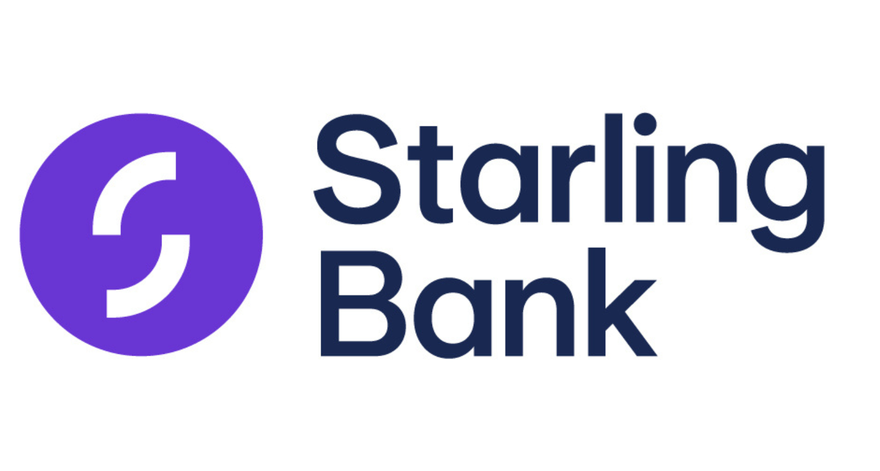







These SME banking trends are no longer differentiators in 2026 – their absence is a deal-breaker
Acquire & onboard instantly
  KYC automation has reduced onboarding times by over 60% in some regions, and SMEs now expect business-account opening to be measured in minutes, not days
  Fintech adoption among SMEs is driven primarily by frictionless onboarding, strong digital capabilities and constant innovation — in 2025, half of UK SMEs (49%) held a business banking product with a fintech
Serve daily through mobile-first channels
  Mobile app usage has overtaken online banking in most markets; over half of UK SMEs (54%), with Canada and the US close behind at 45%, and Malaysia leading at 60%, now use mobile banking apps weekly
  The app is increasingly the relationship: Accenture frames it as the "heart of the relationship" with around 150 interactions per year — a large untapped opportunity to convert these touchpoints into advisory moments
Manage business finances in one place
  SMEs expect a single place to manage accounts, payroll, invoicing, and payments with a real-time view of cash flow and overall business performance — not separate logins for separate products
Build trust through visible security
  With 1 in 4 SMEs in the UK (24%) and Canada (23%), and over a third in Australia (36%), now ranking cybersecurity as their top business challenge, banks are productising security itself as a confidence-building feature rather than a back-office function

Slide 52

















Global and regional banks investing in SME banking extensively
Immediately effecting:
Acquisition
Payments
Lending
Retention
Anchors of success
Description of success
Best case examples
Game Changers
1
Ecosystem-led value chain banking by leveraging anchor counterparties and supplier data
SME proposition built around anchor buyers, suppliers, marketplaces or platforms, using verified trade flows, invoices, purchase orders and payment history to originate, onboard, underwrite and cross-sell SMEs
2
Beyond-banking ecosystem / “business-in-a-box”
Integrated SME operating platform combining banking with formation, accounting, invoicing, tax, payroll, legal, e-commerce, marketplace access and advisory services
Incumbent moves
3
Frictionless digital onboarding and activation
Fully digitized account opening, KYC, document submission and first-product activation
4
Data-led instant working capital
Pre-approved and dynamically sized working-capital limits using transaction, POS, invoice, tax, accounting, registry and behavioral data from ecosystem sources
5
Cash-flow intelligence / CFO-lite tools
Client-facing cash-flow tools that forecast liquidity, monitor receivables and payables, flag expense or funding risks, and recommend next-best actions for SME owners
6
Supply-chain finance product expansion
Broader anchor-led supply-chain finance suite covering reverse factoring, approved-payables finance, dynamic discounting, distributor finance
7
Segment-specific packs and verticalization
Tailored propositions, pricing, onboarding, advice and credit policies for archetypes such as sole traders, merchants, exporters and e-commerce sellers
8
Growth advisory, education and communities
Relationship-deepening model offering training, coaching, expert access, peer communities, sector insights and partner referrals to support SME growth
9
Regional and state-backed SME growth corridors
Targeted propositions for priority regions, economic zones, sectors or cross-border corridors, supported by state funds, guarantees, co-lending schemes
Enablers
10
Unified SME data layer
Single SME profile built from banking, accounting, e-invoicing, POS, tax, registry, bureau and ownership data, powering personalization, credit and servicing
11
AI / straight-through risk and service factory
Automated operating model for onboarding, KYC, document processing, eligibility checks, credit decisioning, with human intervention only for exceptions
12
Hybrid digital + relationship-manager model
Digital self-service for simple needs, with analytics-enabled RMs covering complex SMEs, next-best actions, churn risk and cross-sell opportunities
1

Slide 53

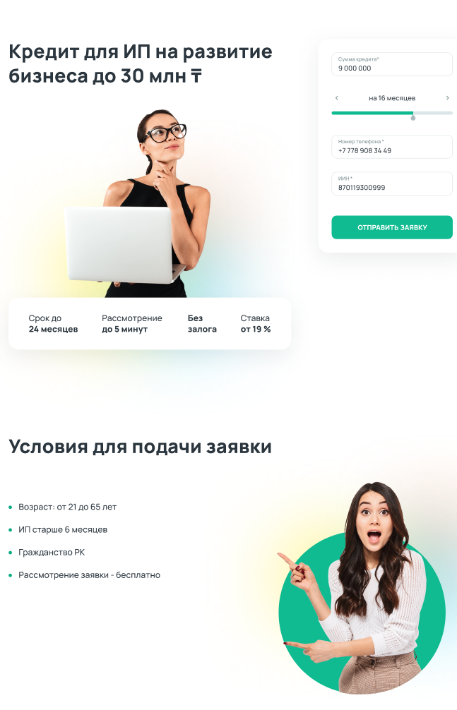
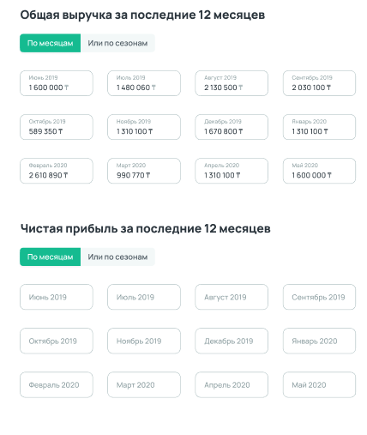
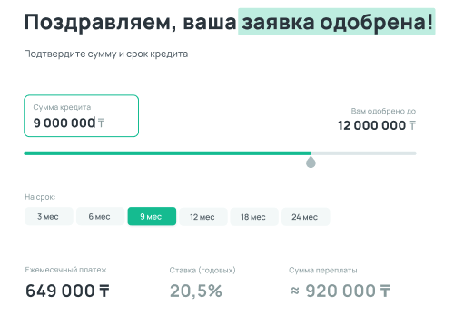
In order to better serve SMEs, Halyk digitized core banking products, creating first fully digital SME loan in Kazakhstan market
Unsecured lending up to $200k
Revenue estimation and scoring within 3 minutes
Disbursement within 10 minutes
First fully digital SME loan on the market
Started as unsecured lending for sole traders, then expanded into secured and enterprise lending
Total revenue for last 12 months
Congratulations! Your loan application has been approved
Business loan
up to 30M T
By month
Or by season
Please confirm the terms and conditions
Total profit for last 12 months
The product accounts
for 94% of SME loan disbursements
By month
Or by season
Loan conditions
  Age: from 21 to 65 years
  Enterprise registered more than 6 months ago
  Kazakh citizenship
  Decision making is free of charge
<10 minutes TTM
Launched in 6 months

Slide 54
As competition intensified, Halyk explored new innovative non-core solutions and launched a digital B2B marketplace
OnlineDuken digitizes the full cycle of ordering, deliveries and payments
between wholesale distributors and grocery stores
70+ wholesale distributors’ product catalogue available
Embedded supply chain financing
Loyalty program for merchants
$85m GMV one year after launch
~10% share of wholesale grocery market by end of year
~20% of grocery shops in the country are users
+16% in average
bank balance per user
vs non-user
Launched in 9 months

Slide 55
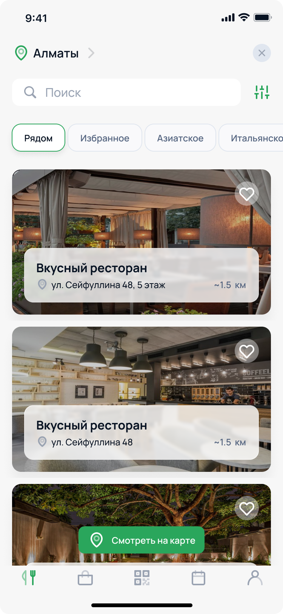
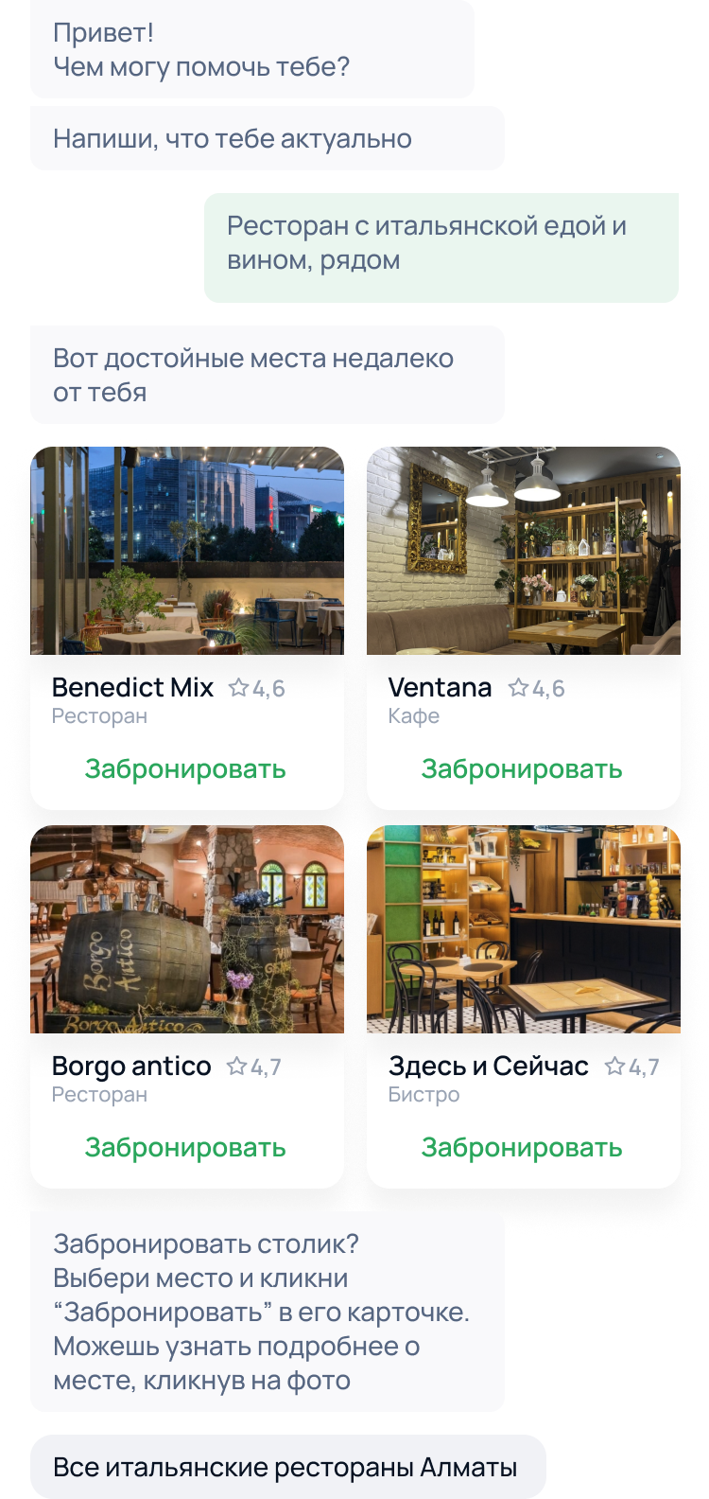
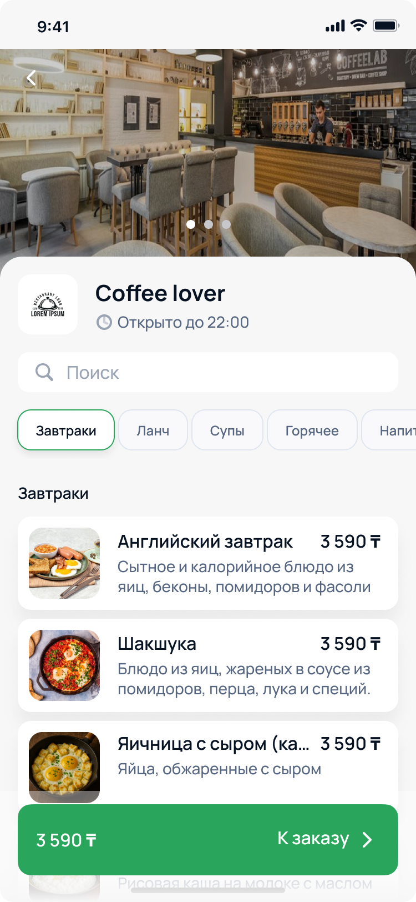
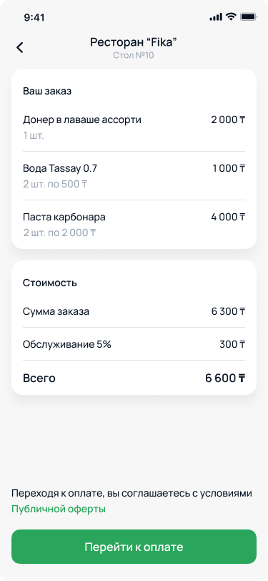
Ecosystem is now expanding the B2C lifestyle offering with Halyk Restaurants
The solution will allow customers to book venues, place orders, and make payments
Pre-ordering / ordering without a waiter
Restaurant selection
AI-based booking assistant
Payment with a QR / in-app
~15% share of country’s services turnover (HoReCa, beauty, etc.) by 2030
Later expansion into
wider services is planned: beauty, wellness, sport, etc.

Slide 56



Banks are using AI and advanced analytics to turn customer, risk and operational data into measurable revenue, control and productivity gains
Advanced analytics value tree
Leading bank examples
Commercial
effectiveness
Client profitability
Customer behavioral segmentation
1-2-1 pricing
Transactional analytics
Used real-time NBtB and 1-2-1 pricing models to deliver more relevant offers resulting in 19x growth in conversions
Client acquisition
and retention
Churn reduction analytics
Customer experience analytics
Risk control
Risk losses
Digital credit assessment
Advanced EWS
Credit collection analytics
Applied AI to improve fraud detection and reduce manual investigation workload resulting in moving from a low ~40% fraud detection rate, reducing false positives by ~50–60%
Next generation stress testing
Fraud losses
Fraud detection analytics
Operational
efficiency
Operational costs
Geospatial analytics
Productivity optimization
HR management
Predictive HR
Used process mining to identify bottlenecks and remove unnecessary approval steps before automation resulting in 116,000 man hours saved
Financial control
Financial control
Advanced financial analytics
Trading analytics

Slide 57
For Next-Product-To-Buy, banks use collaborative filtering and propensity models to drive a 10-15% revenue uplift
Approach
  Took a data driven approach to increase cross-sell and upsell
Next-Product-To-Buy Engine
Input
Model
Output
Data
  Used both internal and external data with more internal data (approx 3:1) – see diagram on right
Inter-nal data
  Client information (Industry, coverage)
  Credit information (e.g., volume by maturity, drawn)
  Product revenue/volume with +40 categories
  Commercial activities (e.g., client meetings, opportunities)
  Business flow (e.g., payments)
Opportunity by client
Group – Sub.
Poten-tial
Products
Model
  Clustered customers by product revenue / volume using a collaborative filtering – i.e. using behaviour of similar customers to inform what customer may like
  Clustered customers by likelihood to buy –using the internal and external data sources and applying machine learning
  Weighted the two to create next product to buy recommendations
007 – Subsidiary UK
Import Finance
20k€
007 – Subsidiary New York
DCM (Dollar issuance)
50k€
Collaborative
filtering model
based on product revenue/ volume
010 – Head-quarter
Factoring
65k€
012 – Head-quarter
Cash pooling
10k€
Testing
and proto-typing
  Then tested model recommendations with RMs, with a high success rate
  Took 3-4 months to prototype
Propensity model based on client info and external
data
2123 – Head-quarter
Rates derivatives
35k€
Exter-nal data
  Client financials (e.g., turnover, EBITDA, ROE)
  Industry data (e.g., sector growth and profitability)
  Non client information (financials and product)
Impact
  Expect 10-15% revenue uplift as a result
Extending
  If done in conjunction with segmentation, one can prioritise opportunities identified based on client/product profitability
Source: Team analysis

Slide 58
For churn reduction analysis, banks trace customer journeys to understand root causes of customer dissatisfaction
Situation1
  US bank with $90B in revenues
  Bank’s front line services encounter 250 million multichannel customer touch points per year
  Customer satisfaction scores (CSAT) were significantly lower than industry peers
Approach
  Installed an analysis tool to process all customer data available
  Visualised the customer journeys and root causes of customer dissatisfaction
  Developed action plan (including trainings, adjusted calls scripts, etc) to improve relevant touch points and provide a satisfactory experience
  Optimised service spend accordingly (i.e., increased service spend where it gives impact, decreased service spend elsewhere)
Example of journey visualisation
Autopay (IVR)
Account info
(mobile)
Churn
Tool identified that most churners take the following journey and root causes of dissatisfaction are X and Y
Retrieve customer ID/password
(e-mail)
FAQs (chat)
Retention call
(agent)
Rewards
use (Web)
Feedback about experience (social media)
Set up a new account (branch)
Card activation (IVR)
Partner offers
setup (Web)
Billing issue
(chat)
Reposition mobile app (mobile)
Payment (IVR)
Opt-in alerts
(mobile)
Credit increase
request (agent)
Data usage
  Used internal data – as this activity is focused on retaining current customers
  Data allowed bank to trace each dissatisfied customer through their journey with the bank, looking at activity at each stage of the journey
Impact
  Drove up CSAT by 5-10 ppts
  Decreased customer churn by 2%
  Reduced service cost by 10-25%
  Duration of outstanding loans/credit lines in maturity
  Time since last visit by RM or Specialist
  Cash balance relative to size
  Duration of cash management relationship
Other metrics
that
players
use
  Growth of fees relative to GDP / sector growth
  Number of administrative changes / user access requests
  Win rate in competitive transaction products
1. Was a retail bank although there are many parallels with SME bank; 2 Used ClickFox
Source: Team analysis

Slide 59
Backup

Slide 60
RM scorecards for commercial need to be further specialized...
Commercial RM Scorecard KPIs
  Key Recommendations
1
60%
Squad KPIs
20%
  Net Revenue
1
  60% Squad KPIs for sales professionals owning own sales portfolios is above benchmarks (app. 20% for team level KPIs) – where individual targets for RMs lack prioritization
30%
20%
  Portfolio
15%
  Deposits/Turnover (Payment)
  Do not have individual interest income KPIs leading to failed pricing strategy reinforcement
2
2
15%
  Risk Cost
3
20%
  Penetration (Salary Product)
  Penetration is specialized through only one product (Salary), which should be on multiple product level based on client portfolio
3
10%
  CIB CSI
  Do not have individual interest income KPIs leading to failed pricing strategy reinforcement
40%
Individual KPIs
4
40%
  Gross Income (Non-interest)
4
70%
25%
  Credit Portfolio EOP balance
  Product such as deposit and TF should be targeted based on cash portfolio targets
5
5
15%
  Total deposits EOP balance
6
20%
  Introduce customer activation as a main pillar for the commercial segment scorecards
  TF portfolio EOP balance

Slide 61
...and lacking important KPI sets relevant for commercial banking
What is not in the current RM scorecards for commercial banking
How do suggested KPIs support increased focus on commercial segment?
Best practice scorecard categories for commercial banking
Category
Weight
Metric Examples
1
Activation & Portfolio Productivity
Financial & Volume Metrics
30%
Total loan volume, Cash loan volume, Non-cash loan volume, Deposit volume, Loan-to-deposit contribution
With +40% inactivity level in the commercial banking client portfolio and new business growth targets, individual KPI targets are needed on both;
  Lead conversion (based on account planning targets) and
  Activation (based on revenue generation principle)
Revenue Metrics
25%
NII, NFI, Revenue per active client, Product revenue diversification, Revenue contribution across lending, deposits, payments, FX, trade
Activation & Portfolio Productivity
20%
Active portfolio ratio (Share of RM portfolio generating revenue in defined period), Inactive-to-active conversion, Lead conversion, Product penetration per client
1
2
UW & Credit Quality
10%
Approval rate quality, NPL / delinquency ratio, early warning follow-up, collateral / documentation completeness
2
UW & Credit Quality
Digitalization & Transaction Banking
10%
Digital channel activation, payments / cash management usage, self-service migration
Approval rate of cash/noncash credit applications, collateral and documentation completedness are KPIs regarding underwriting processes
They ensure RMs take ownership of credit decision principles based on market trends/segment specifities
Client Experience & Conduct
5%
Client satisfaction, response time, compliance and conduct

Slide 62
Effect from the introduction of AI agents and processes revamp in Underwriting: productivity growth
Preliminary
From the previous year²
From the current year
Corporate: Net Interest Income after risk (mn AZN)
Corporate: Increment in loans granted (mn AZN)
Corporate: Loans volume granted annually (2025 eq, mn AZN)
6,3
8,7
0,5¹
3,2
3,2
2,0
4,3
3,3
1,226
1,226
1,226
0
5,4
2027
28
2029
2027
28
2029
2027
28
2029
Corporate: Net Interest Margin after risk (%)
Corporate: Productivity growth
(%)
3.5%
3.5%
3.5%
15.0%
20.0%
25.0%
2027
28
2029
2027
28
2029
Pretax Income Increment
(mn AZN)
Commercial: Net Interest Income after risk (mn AZN)
Commercial: Increment in loans granted (mn AZN)
Commercial: Loans volume gran-ted annually (2025 eq, mn AZN)
+
0,5¹
5,4
10,4
14,2
1,4
0
2,6
0,7
3,4
1,1
69
92
229
229
229
2027
28
2029
1,4
1,8
2,3
2027
28
2029
2027
28
2029
2027
28
2029
Commercial: Net Interest Margin after risk (%)
Commercial: Productivity growth (%)
Introduction of Agentic AI in Underwriting will:
increase the productivity of the current staff through the seamless process of forming the credit decisions
as an enabler secures 10-14 mn AZN³ of Pretax Income from the expansion of lending
4.0%
4.0%
4.0%
30.0%
40.0%
50.0%
2027
28
2029
2027
28
2029
SME: Net Interest Income after risk (mn AZN)
SME: Increment in loans granted
(mn AZN)
SME: Loans volume granted annually (2025 eq, mn AZN)
0,5¹
0,8
0,8
0
1,1
1,6
0,5
1,4
2,1
0,7
82
272
272
272
2027
28
2029
2027
28
2029
2027
28
2029
SME: Net Interest Margin after risk (%)
SME: Productivity growth
(%)
2.1%
2.1%
2.1%
30.0%
40.0%
50.0%
Coefficient for converting into the average annual portfolio
Net Interest Income generated by the increment in the loans granted during the previous years
starting from 2028
2027
28
2029
2027
28
2029
McKinsey & Company
62

Slide 63
Individual RM performance differentiate significantly due to squad level KPI management
Commercial Heavy Squad
Commercial Light Squad
Recommendations
Sectors covered
  Manufacturing, Construction, Energy, Trade of construction goods etc.
  Trade (FMCG), Retail & Horeca, Telecom
  Based on workload and active potential individual RM portfolios can be re-distributed to equalize income generation and asset growth opportunity upon scorecard and KPI approach change
  Distribution approach should be based on
    Daily workload
    Customer preference
    Sector specialty
    RM seniority and scorecard applicability
78.4
86.9
Total of average cash & non-cash loan portfolio
51.6
35.5
12.6
26.1
11.8
14.3
27.3
20.1
11.7
24.4
12.6
0.9
0
6.7
0.4
11.1
RM 1
RM 2
RM 3
RM 4
RM 5
RM 6
RM 7
RM 8
RM 9
15.2
Total banking income managed
9.7
8.5
6.1
6.3
7.1
4.0
2.1
Ø 7
0.7
RM 1
RM 2
RM 3
RM 4
RM 5
RM 6
RM 7
RM 8
RM 9
0.7
NII + NFI per client group
0.5
0.5
0.3
0.4
0.3
Ø 0.4
0.2
0.2
0.2
RM 1
RM 2
RM 3
RM 4
RM 5
RM 6
RM 7
RM 8
RM 9

Slide 64
UW process is not specialized for commercial segment...
...introduction of a specialized UW track to expedite process
Current Credit Decision flow for corporate and commercial
Recommendations to change for commercial banking track introduction
Application
1
Creating a tailored document requirements checklist for commercial customers with
(a) desirable customer risk profile
(b) unstructured products
(c) exposure amount lower than threshold to be set
1
Document Check
Booking
Loan workbench analysis
Acceptance
2
UW analyses to be re-evaluated and deisgned based on the available financial data and sophistication with more fit-for-purpose underwriting approach rather than full UW profiling
2
Customer identification
Disbursement
2
3
A new committee layer to be founded based on the commercial credit decisioning level specifically for commercial banking track UW decisions
New level of risk delegation should be considered based on the UW and risk committee guidance
2
Financial Verification
Decision
2
3
Risk Analysis + Stress Test
Decision Body

